Slide 1


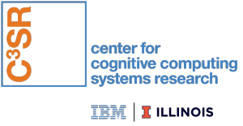

Post-Quantum Stateful Hash-Based Signature Scheme for Improving Bluetooth Security
Andres Colon, Ian Lieu, Peter Anthony, Arron Lu
Advisor: Professor Mohamed El-Hadedy
Assistant Professor, ECE-department, College of Engineering
California State Polytechnic University, Pomona
Team: Post-Quantum on-Chip

Slide 2

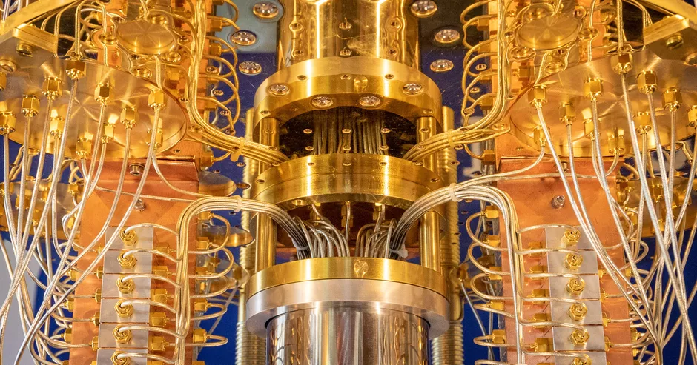



Motivation
Quantum Computers
Post-Quantum
Quantum Cryptography
Hash-Based Signatures
Shor’s Algorithm
Bluetooth Public-Key Exchange
IoT/Low-Power Devices
Notes:
https://en.wikipedia.org/wiki/Shor%27s_algorithm

Slide 3
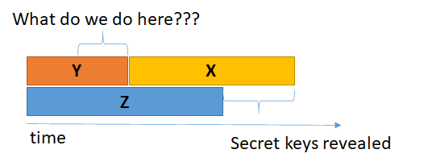
Post-Quantum
Mosca’s Inequality Theorem:
If X + Y > Z, then security is broken
X: shelf life of existing security standards
Y: time to migrate from current crypto standards to a quantum-safe environment
Z: time for a large-scale quantum computer to be built
[1] Dr. Michele Mosca “Cybersecurity in a quantum world: will we be ready?”

Slide 4
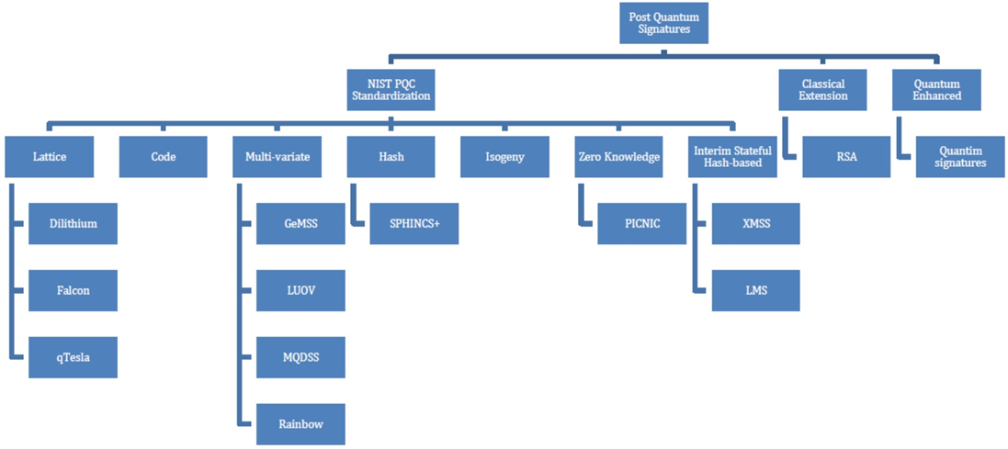
Post-Quantum Signatures
[2] Teik Guan Tan, Jianying Zhou, A survey of Digital Signing in the post Quantum Era (Singapore University of Technology and Design, Singapore)

Slide 5
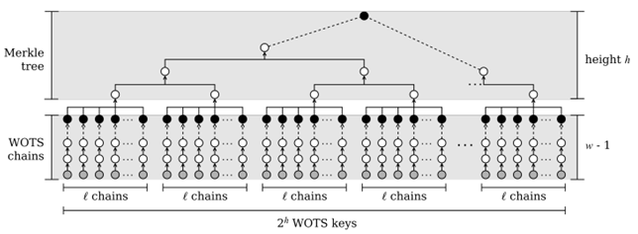
LMS: Leighton-Micali Signatures
[3] Campos, Kohlstadt, Reith, Stottinger, “LMS vs XMSS: Comparison of Stateful Hash-Based Signature Schemes on ARM Cortex-M4”

Slide 6
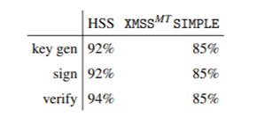
Hash
Percentage of Time Spent on Hashing
SHA-1
SHA-2 256/512
SHA-3 (SHAKE)
Lightweight Hash (LWC: Lightweight Cryptography)
GAGE Hash Function
[3] Campos, Kohlstadt, Reith, Stottinger, “LMS vs XMSS: Comparison of Stateful Hash-Based Signature Schemes on ARM Cortex-M4”
Gage Security Range Greater Than: 2¹¹² or 2¹²⁸
Low-End IoT Device Security Range: 2⁸⁰ – 2⁹⁶

Slide 7
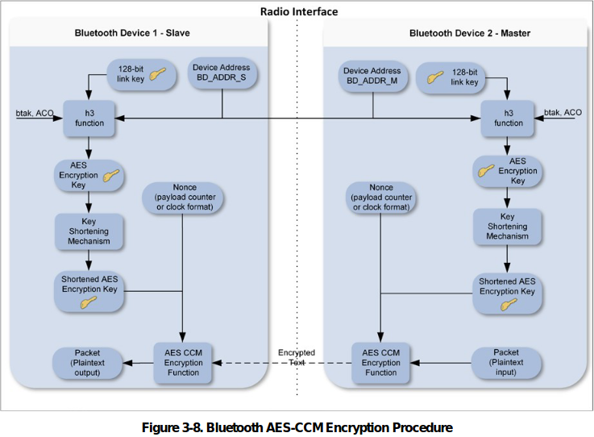
Bluetooth
[4] “NIST Special Publication 800-121 Revision 2, Guide to Bluetooth Security”

Slide 8
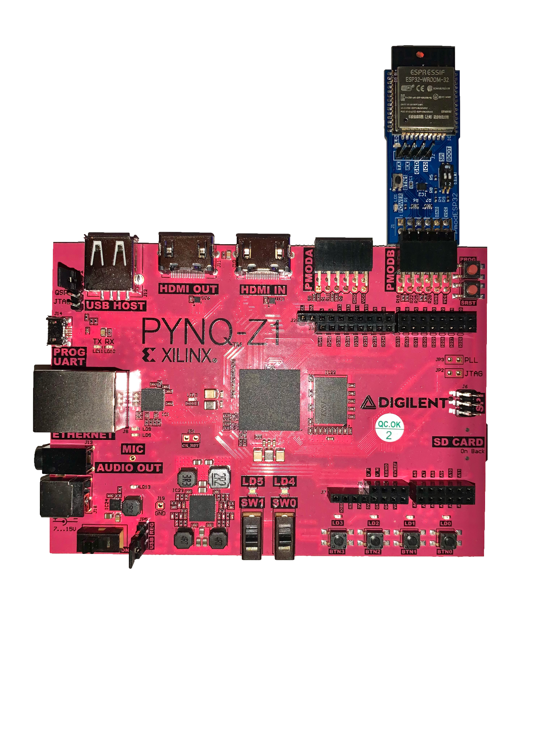


Our Goal
IoT Communication with Post-Quantum Security
Hash-Based Signature Scheme Acceleration
PYNQ-Z1 SoC
ESP-WROOM-32 (ESP32) Pmod

Slide 9
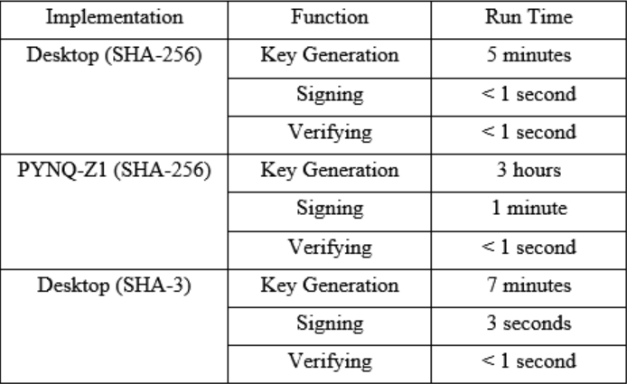
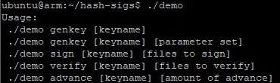
Test Results: LMS
LMS Functions
Specifications:
Desktop: Intel Core i7-6700K CPU @ 4.00GHz, 16GB DDR4
PYNQ-Z1: Cortex-A9 ARM Processor @650MHz, 512MB DDR3

Slide 10
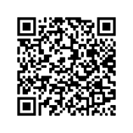
Demo
https://github.com/Reconfigurable-Computing-CalPoly-Pomona/postquantum_crypto_signature-
https://youtu.be/IqCrmpDdR1I

Slide 11
Future Works
LMS
Replace Open-SSL SHA-256 in software with a SHA-256 hardware core
Develop a lightweight hash compatible with LMS
Bluetooth
Implement a fully functioning Btstack onto bluetooth device
Replace authentication model, AES to LMS

Slide 12
References
Dr. Michele Mosca “Cybersecurity in a quantum world: will we be ready?”
Teik Guan Tan, Jianying Zhou, “A survey of Digital Signing in the post Quantum Era” (Singapore University of Technology and Design, Singapore)
Campos, Kohlstadt, Reith, Stottinger, “LMS vs XMSS: Comparison of Stateful Hash-Based Signature Schemes on ARM Cortex-M4”
“NIST Special Publication 800-121 Revision 2, Guide to Bluetooth Security”
https://github.com/Reconfigurable-Computing-CalPoly-Pomona/postquantum_crypto_signature-

Slide 13
Acknowledgement
This research was supported in part by:
Xilinx Inc.
Center for Cognitive Computing Systems Research (C³SR)
US Air Force Research Laboratory, Academy Center for Cyberspace

Slide 14






Ian Lieu
Arron Lu
Peter Anthony
Andres Colon
Prof. M. El-Hadedy

Slide 15

Questions?
Ian Lieu
Arron Lu
Andres Colon
Peter Anthony
Prof. M. El-Hadedy
http://www.recoiot.com/
https://github.com/Reconfigurable-Computing-CalPoly-Pomona/postquantum_crypto_signature-

